Slide 1

A LSTM Based Campus Network Traffic Prediction System
2019 10th IEEE International Conference on Software Engineering and Service Science
Presenter：Zehua Li
Authors： Yue Geng, Shuyu Li
Email：gengyue@snnu.edu.cn
lishuyu@snnu.edu.cn
Shaanxi Normal University, Xi`an China

Slide 2
Background
System Design
CONTENTS
Proposed Algorithm
Performance Evaluation
Conclusion

Slide 3
Background
With the expansion of campus network, the use of network bandwidth increases significantly, which makes the quality of network service not guaranteed. If certain specific methods and corresponding optimization measures were taken, the output bandwidth pressure of the campus network can be effectively reduced and the overall performance of the campus network can be improved.

Slide 4
System Design
Model Display
Network traffic analysis
Network Traffic Prediction
Active Users’ Analysis
User behavior analysis
User Scrutiny

Slide 5
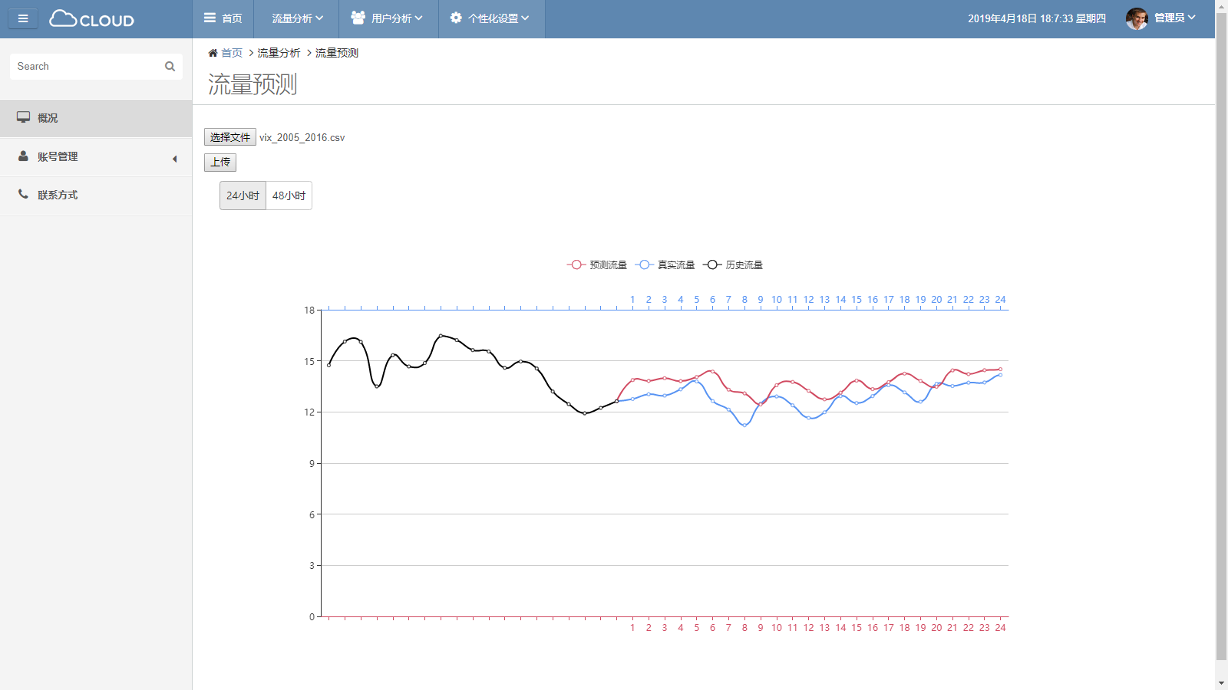
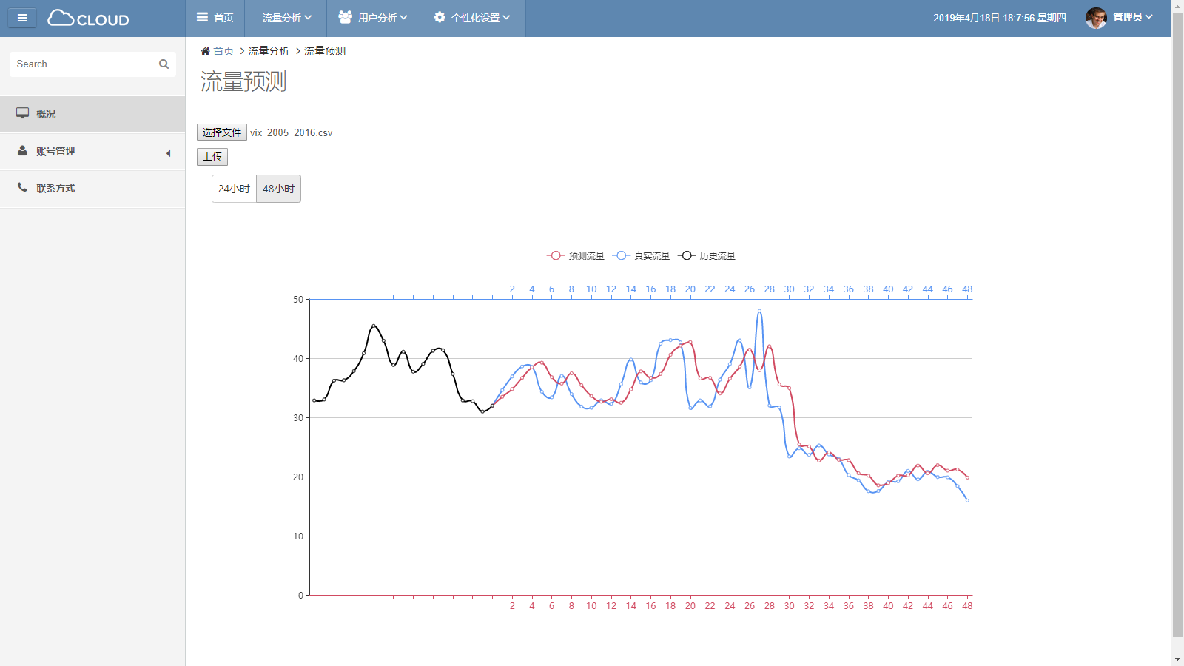
System Design
Network Traffic Prediction
This function visually displays the predicted results of the model by comparing the actual and predicted values. First, users upload historical network traffic log data, and then the system calls the Immortal log analysis tool of Xijia Education to clean up the data. The system uses the processed data as the input data of the training model to obtain the prediction results.

Slide 6
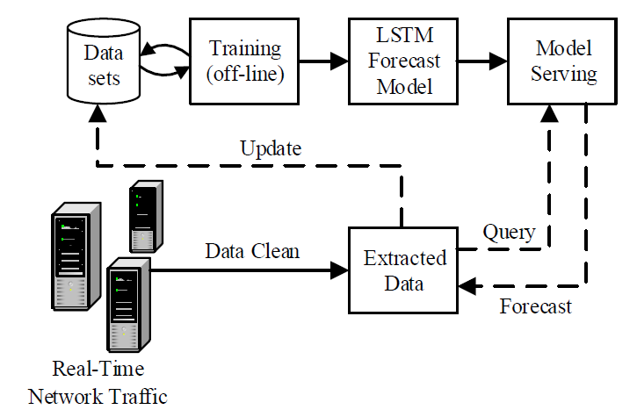
System Design
  Network Traffic Prediction System Framework

Slide 7

System Design
Hardware Environment
01
Intel(R) Xeon(R) CPU E5-2650 v4 @ 2.20GHz
with 32G RAM and 100G hard disk storage
Software Environment
02
Windows Server 2008R2 Enterprise
Python 3.6 Keras 2.2.2 TensorFlow 1.10.0 Numpy 1.15.0
Tomcat 8.5
Data Set
03
The network traffic records are collected from Shaanxi Normal University Network Information Management Center.

Slide 8
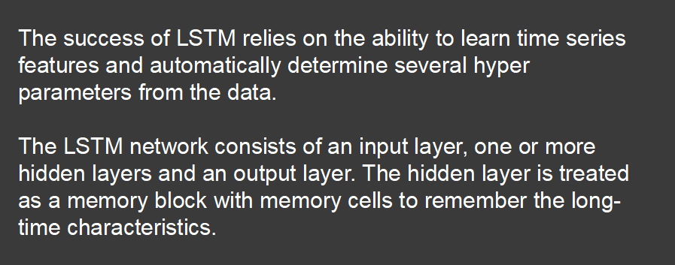
Proposed Algorithm
The LSTM Model

Slide 9
Proposed Algorithm
Training NTLSTM Neural Network
  In this stage, the data is fed to the neural network and trained for prediction assigning random biases and weights. Our NTLSTM model is composed of a sequential input layer followed by 2 LSTM layers and 2 dropout layers followed respectively, and then finally bulid up a fully connected layer with linear activation function.
  In this stage, the output value generated by the output layer of the NTLSTM is compared with the target value. The error or the difference between the target and the obtained output value is minimized by using BPTT which adjusts the weights and the biases of the network.
  We use Immortal tools to deal with big data of multi-source heterogeneous network traffic logs. After the data set is converted to a clean data set, the data set is divided into training sets and test sets for evaluation.
Data Preprocessing
Output Generation
NTLSTM Algorithm Steps

Slide 10
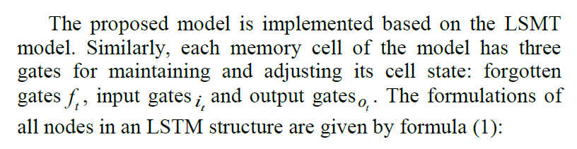
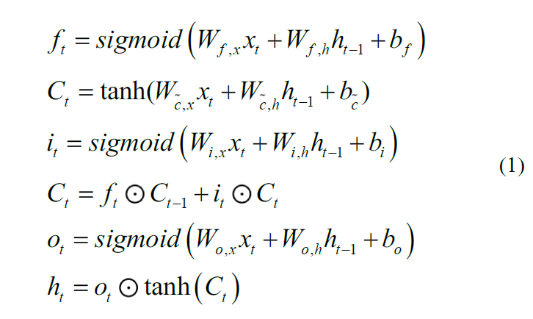
Proposed Algorithm

Slide 11
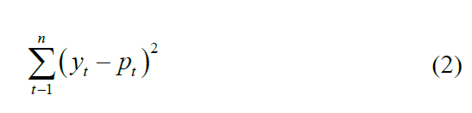
Proposed Algorithm
For objective function we use square loss function given by the following formula (2)：
RMSProp optimizer, a modification of stochastic gradient descent (SGD) optimizer with adaptive learning rates, is applied for back propagation through time (BPTT). Compared with SGD, RMSProp algorithm solves the problem that the loss function oscillates during the update process, speeding up the convergence of the function.

Slide 12
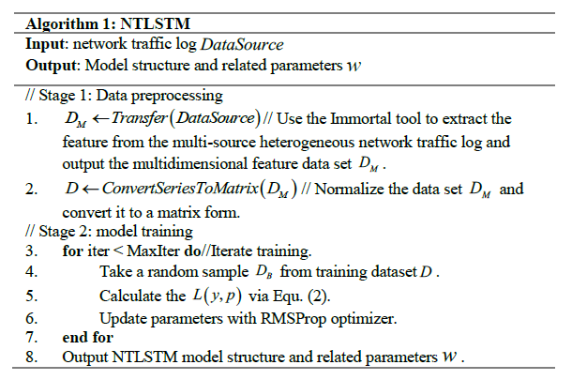
Proposed Algorithm

Slide 13
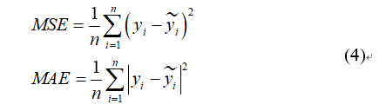
Performance Evaluation
In our experiment, ARIMA, SVR and NTLSTM models are compared. To test our model prediction accuracy better, we use both mean square error (MSE) and mean absolute error (MAE) defined as follows formula (4):

Slide 14
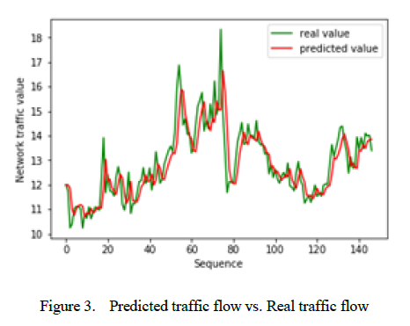
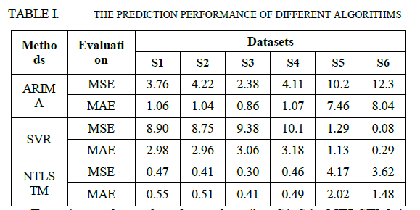
Performance Evaluation
Table 1 demonstrate the prediction performance of different algorithms with six time-series datasets. Additionally, Figure 3 shows the comparison of actual and predicted values of NTLSTM.

Slide 15
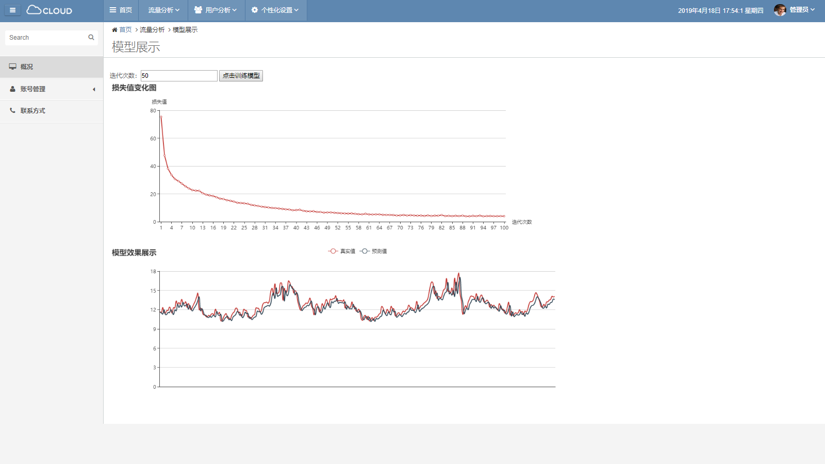
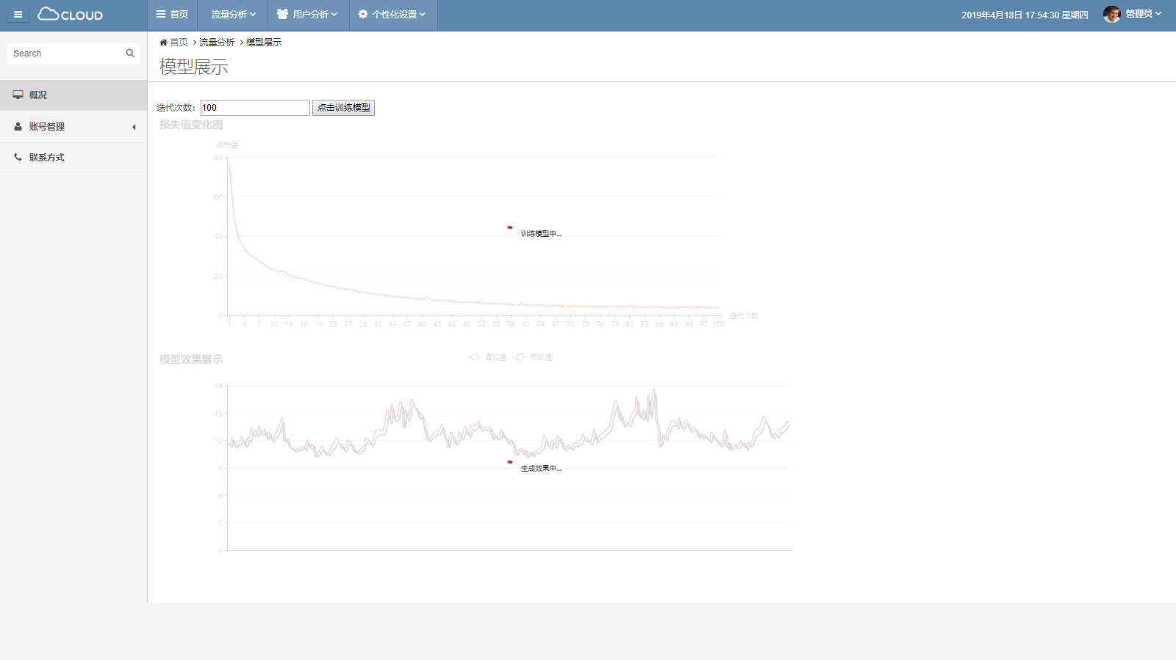
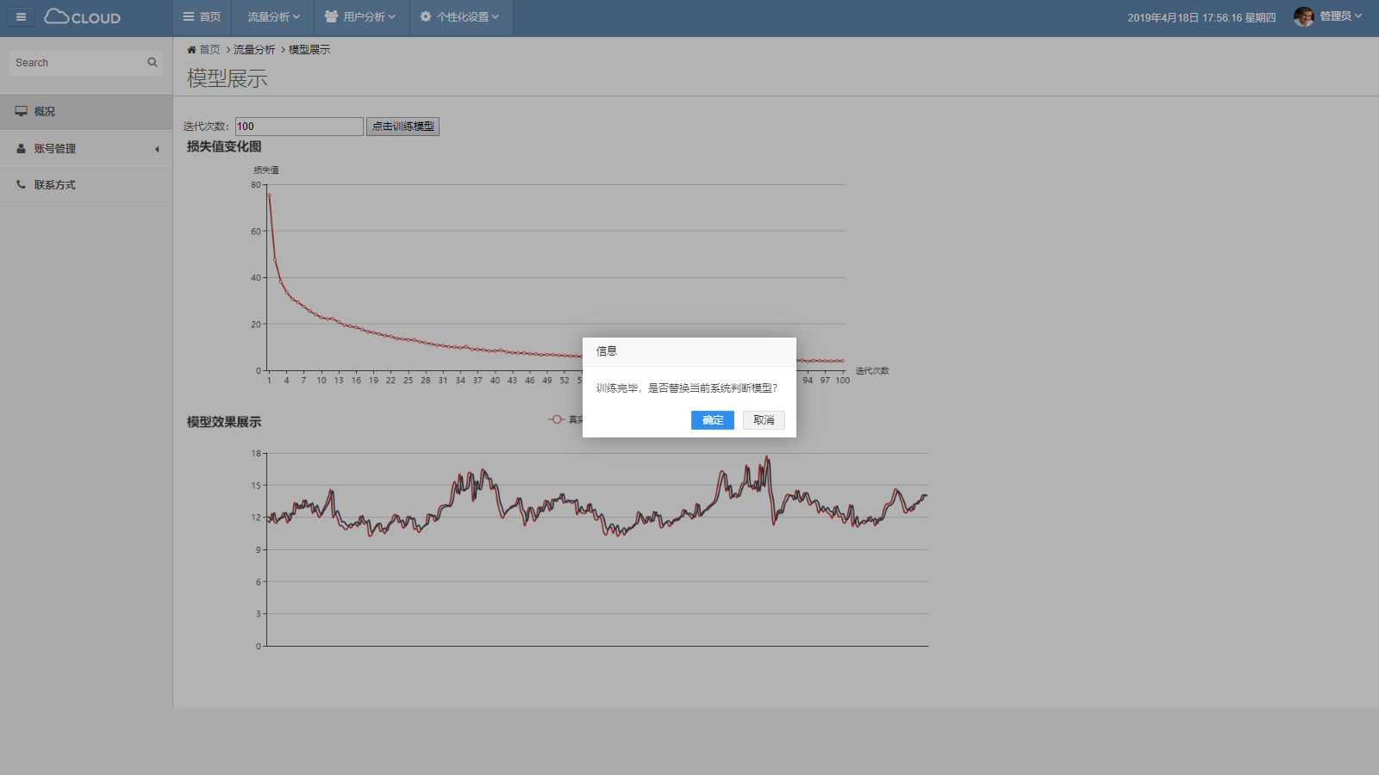
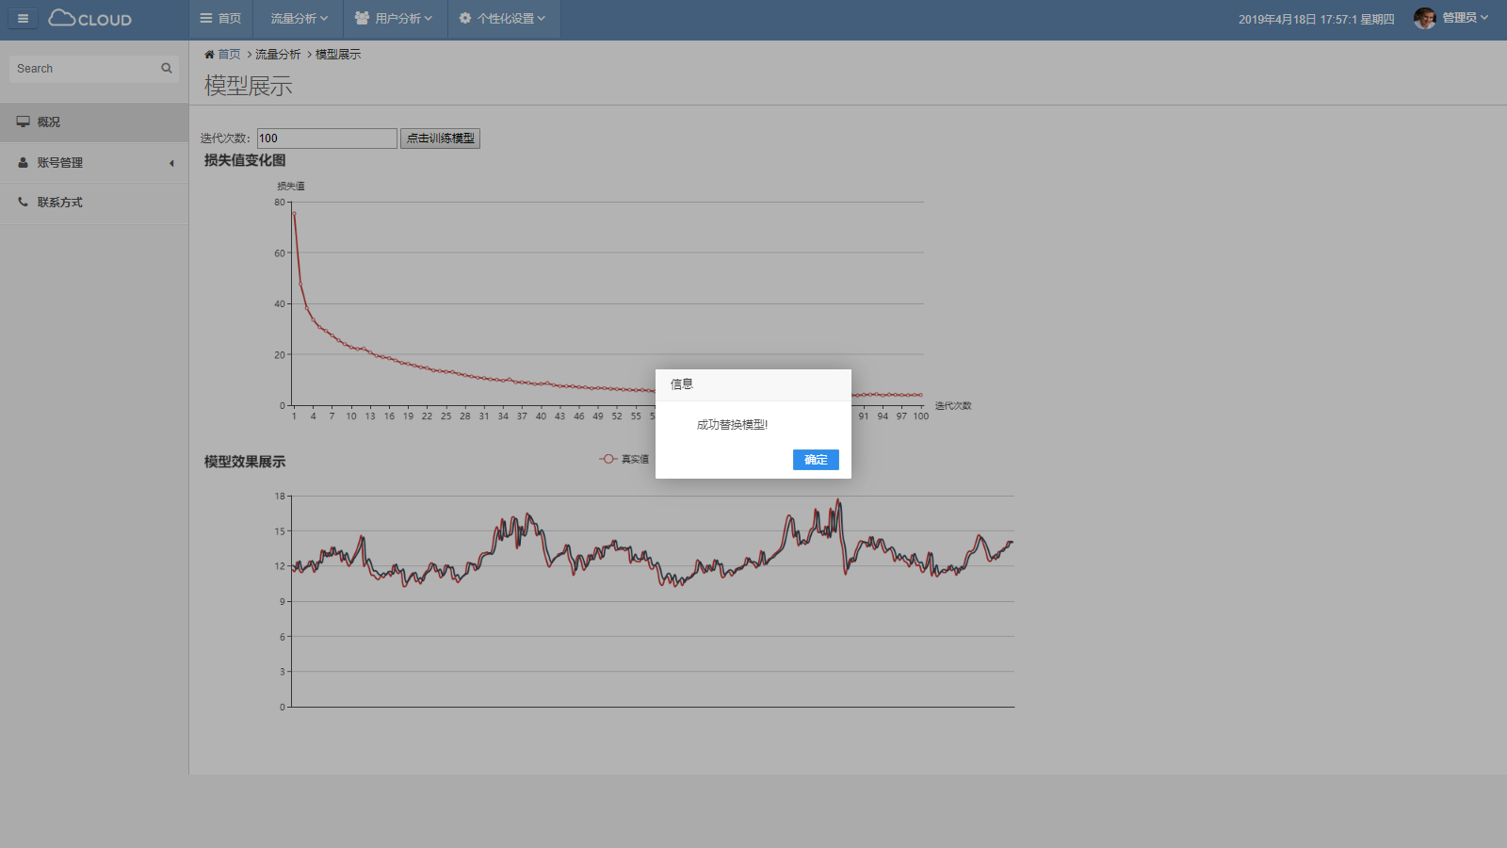
Model Display

Slide 16
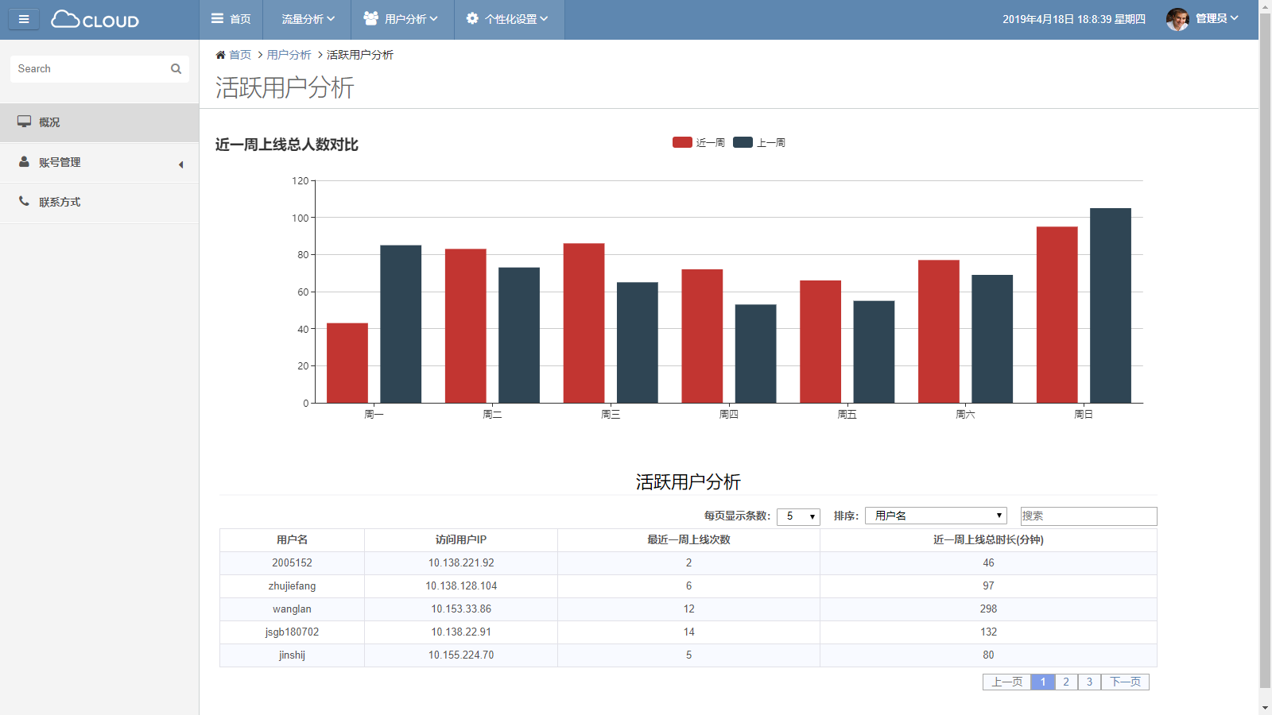
Active Users’ Analysis

Slide 17
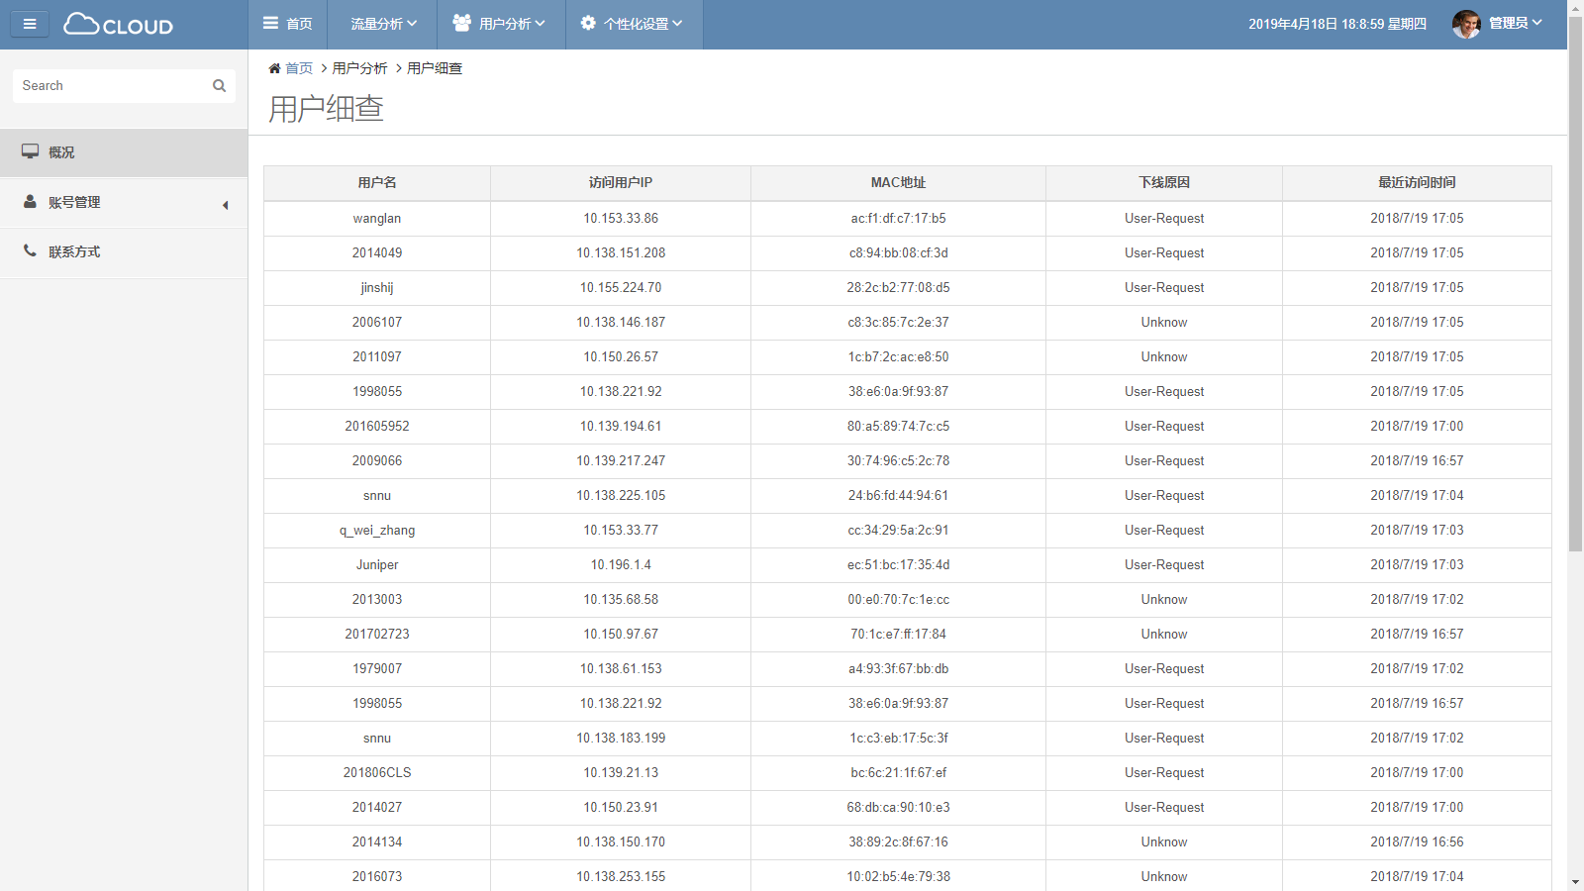
Active Users’ Analysis

Slide 18
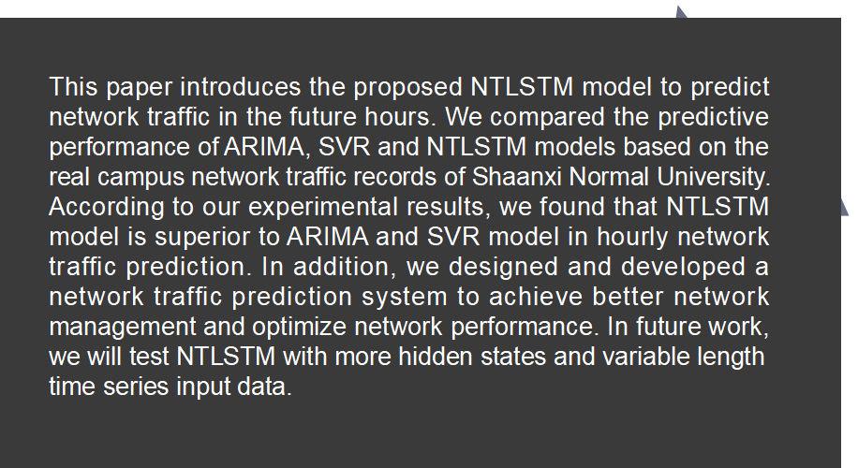
Conclusion

Slide 19
THANKS!

